Slide 1
AI for Crop Growth Monitoring
Presented by
Yatish Agrawal
2018B1A40660P

Slide 2
Introduction
Indoor Agriculture is bound to become a big industry as our populations keep increasing and the land for agriculture will be limited even more. In such an industry the efficiency and controllability is key and so we combine this with another very fast growing industry, AI and automation.
Horticulture monitoring system using machine learning.
Feature extraction from images.

Slide 3
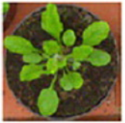
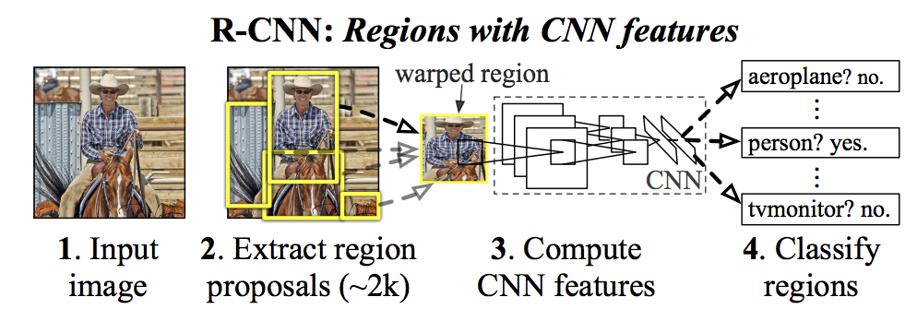
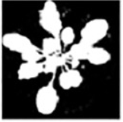
Research Work

Slide 4
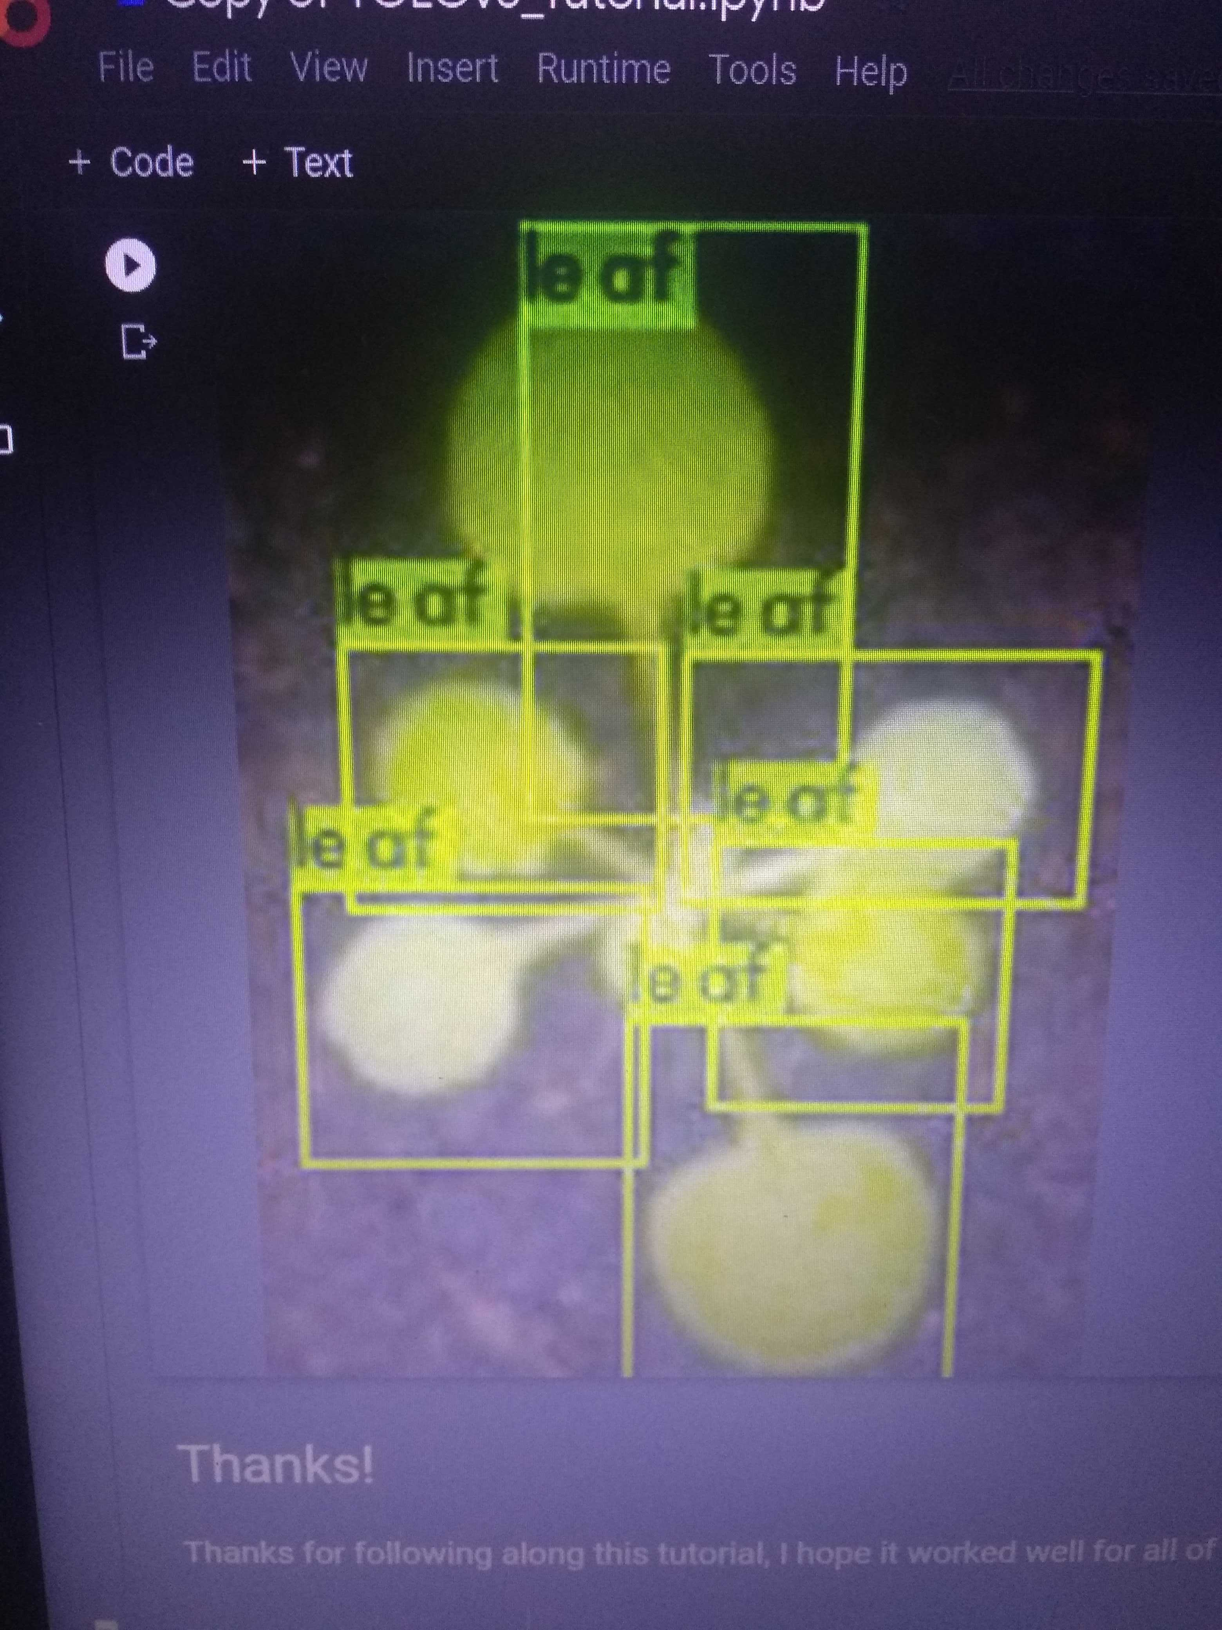
Leaf count with YOLOv3
Leaf count is often used to measure plant age.
We used an open source YOLOv3 and trained on a darknet framework with custom data taken from plant-phenotyping.org/datasets.
Trained on google colab 12 GB GPU hardware acceleration for 4 hours and we got loss value of 2.34 with 120 labelled pictures.

Slide 5
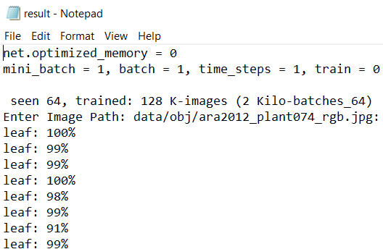
The information we need is the count which isn’t usually provided.
./darknet detector test data/obj.data cfg/yolov3_custom2.cfg /mydrive/yolov3/backup/yolov3_custom2_2000.weights -dont_show < data/train.txt > result.txt
The limiting factor is usually the training data for these models, so as long as we have reliable labelled data we can use it for most plants.

Slide 6
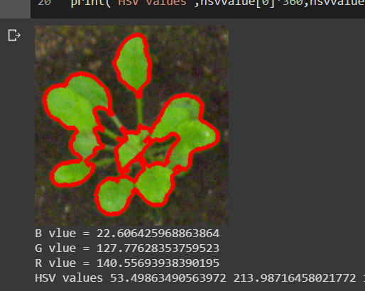
Average colour of leaves
If we can get localized extremes in color. That will improve the disease detection.
The image of the plant is segmented using a k means clustering CNN in opencv.
Method for better results- segmenting 3 times with different values of K and using a bilateral filter.
This gives a mask to check which parts are leaf and we average the pixels color.

Slide 7
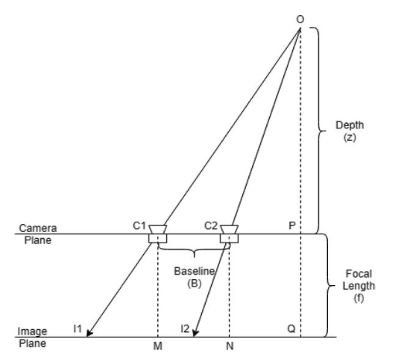
Stereo vision and disparity
Disparity in simple terms is the difference between the two images.
Pixel to pixel matching is the crux of stereo vision. We find the matching pixels and the shift and that is the disparity value.
Depth estimation:
Conventional method: we use the geometric principles and calculate the depth(Z) using the formula -> Z= f*B/d.
Deep learning approach: newly emerging trend, has shown motivating results even with monocular images.

Slide 8
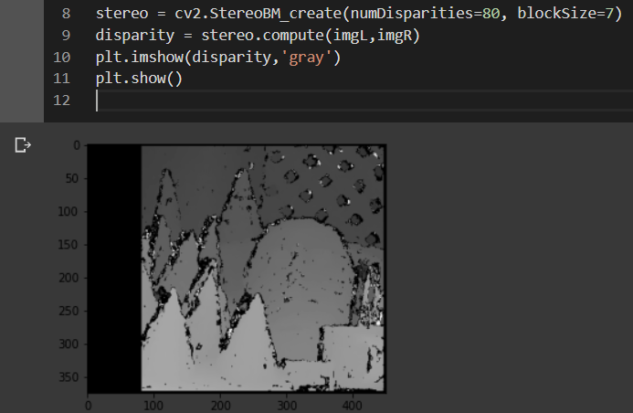
Implications and implementation of stereo vision
Using Opencv we get the disparity values.
We use the YOLOv3 model previously used and get the centres of leaves. And get the depth to it.
We can roughly estimate it to be camera height – shoot length and get the shoot length from it.

Slide 9
Future possibilities of improvements.
With even these rudimentary systems we can get good results so fine tuning and combining these will prove to be exponentially beneficial like:
Using YOLOv3 trained on disease datasets we can locate the plants even in large farms.
By improving the stereo vision system we can possibly get approx. leaf areas in pixels and then use the same to get real values.
It is even possible to get a 3D point cloud with stereo images, this will make almost a virtual model of the plant trays.

Slide 10
Conclusion
These methods are very essential, specially during and post covid19, to reduce human labour and mistakes in large and small scale farms.
The automation will lead to extremely precise monitoring of farms and coupled with AI systems, predict growth and assist in getting the desired yield.
This enables people to efficiently customise the growth of plants according to personal preference and needs.

Slide 11
References
http://www.plant-phenotyping.org/datasets
https://vision.eng.au.dk/leaf-counting-dataset/
https://imageai.readthedocs.io/en/latest/customdetection/#:~:text=Custom%20Object%20Detection%3A%20Training%20and%20Inference,type%20of%20object%20of%20interest.

